Slide 1
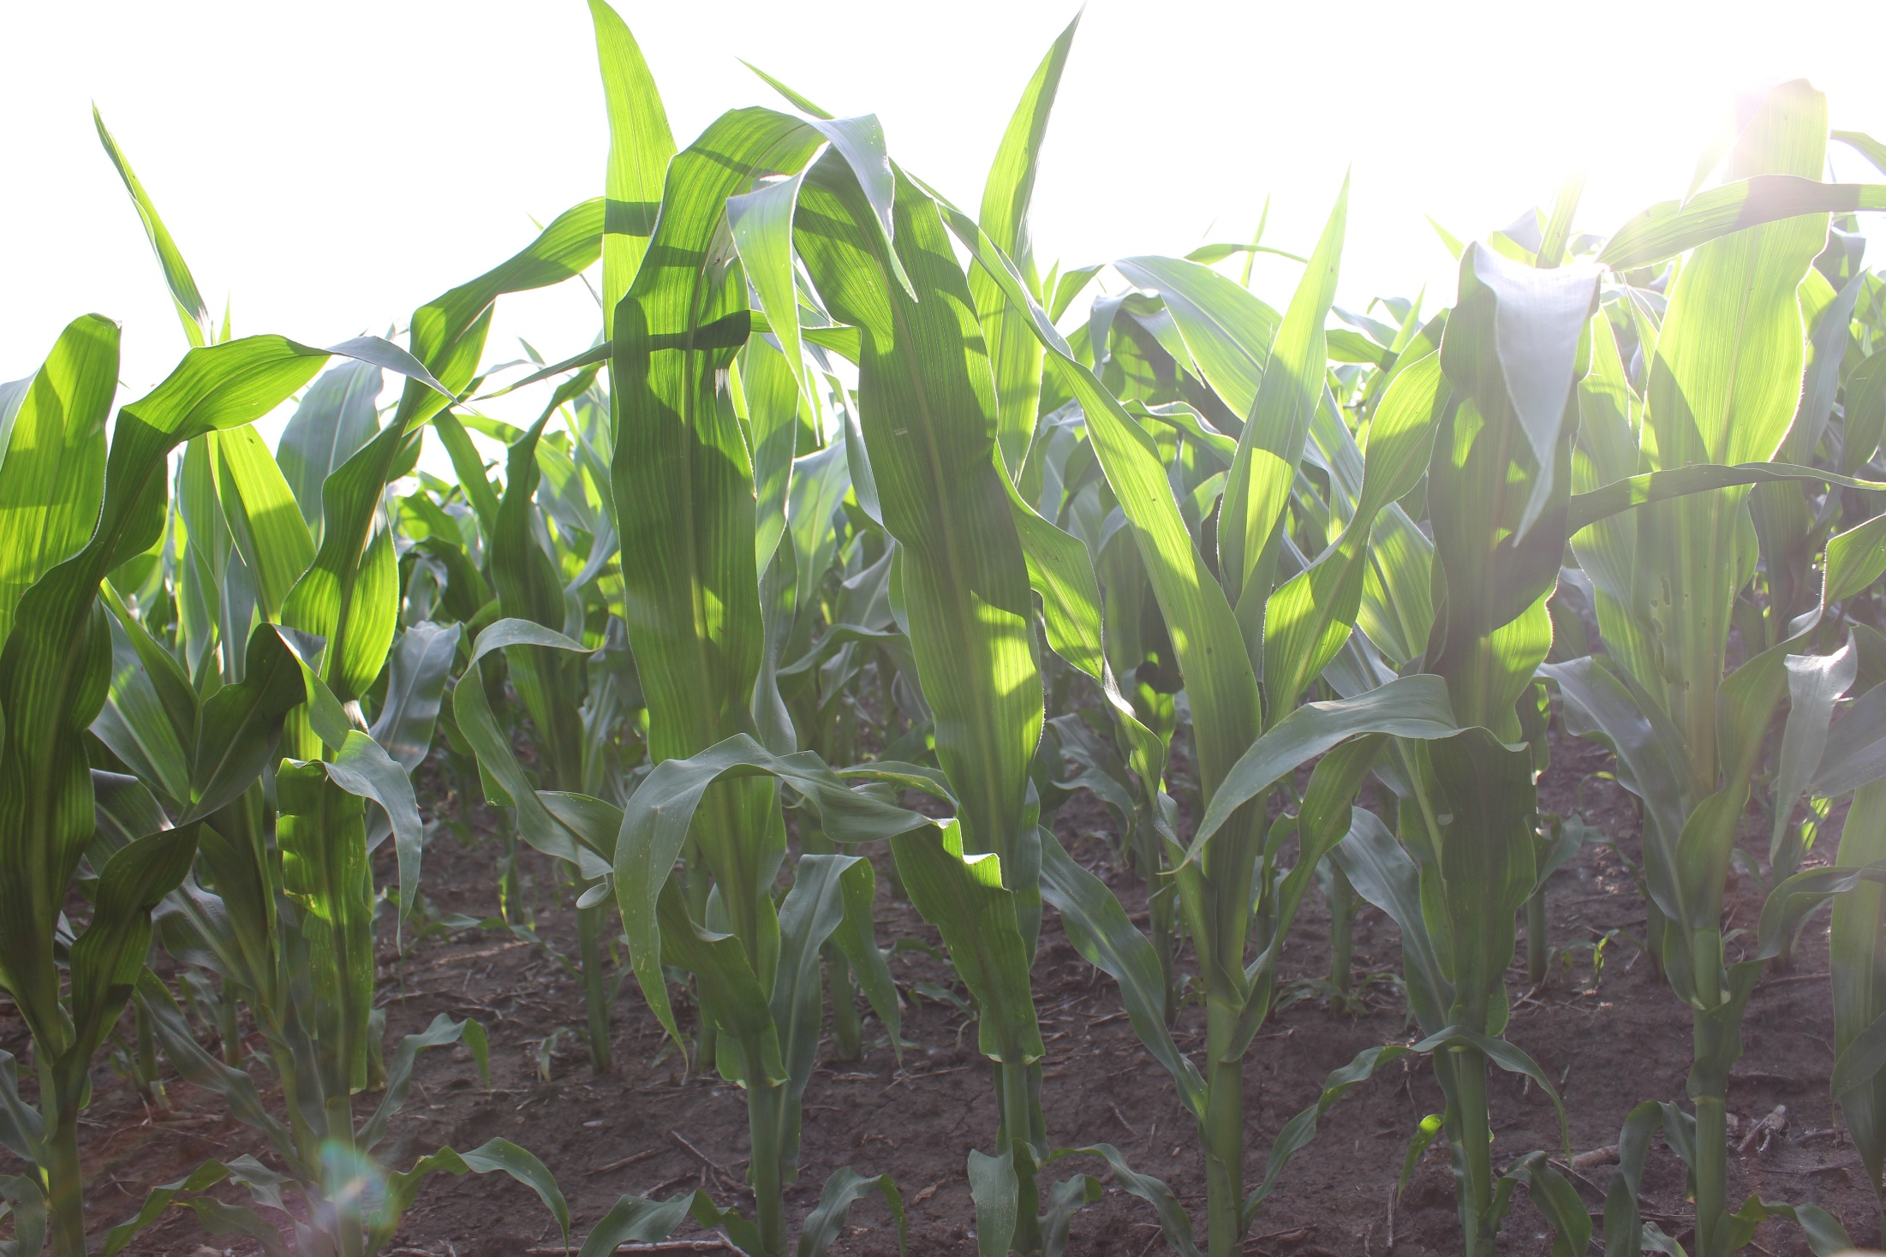

How efficiently do corn- and soybean-based cropping systems use water?
A systems modeling analysis
Ranae Dietzel
February 8th, 2017
Global Change Biology DOI: 10.1111/gcb.13101

Slide 2
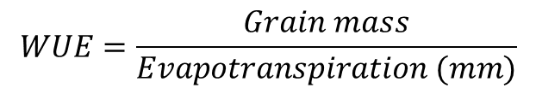
What is efficiency?
$$WUE=\frac{Grain mass}{Evapotranspiration (mm)}$$
How efficient is it to receive water, but not use it?
Notes:
Traditionally, water use efficiency is defined as how much grain is produced relative to how much water is used, which is represented by evapotranspiration. But this is a very yield-based, physiological definition of water use. If we think at the field-scale, we may ask, “How efficient is it to receive water, but not use it? Water loss is also an inefficiency. And it is one with consequences. When we lose water from the systems we lose soil, nutrients, and pesticides which is bad for water which gains these things and for the field that lost them.

Slide 3
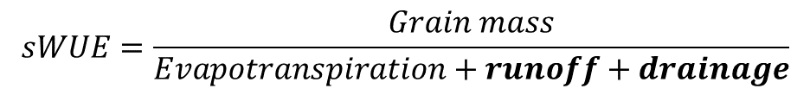
Systems Water Use Efficiency
$$sWUE=\frac{Grain mass}{Evapotranspiration+runoff+drainage}$$
Notes:
So I will be talking about a different definition of water use efficiency – systems water use efficiency. In this definition, we look at grain yield relative to all major water loss, not just ET. In this way, there is an efficiency penalty for water leaving the system. The problem with this definition is that everything in the denominator is very difficult to measure. That is why the subtitle of the presentation is “A modeling analysis”.

Slide 4
Soil temp and moisture
Weather Data
30 years
Soil
Biomass Production
Crop
Management
Evapotranspiration

Slide 5

Agricultural Production Systems Simulator
Modeling platform which includes 60 different models
User-friendly interface
Very transparent – all source code is available
Frequently updated
Developed by the facilitation of broadly-based collaborative science
Free to everyone and suggested improvements are welcomed
Models run on a daily timestep at a field-scale

Slide 6
Comparison of Biofuel Systems
(COBS, est. 2008)
Notes:
This site was near Ames, IA and known as The Comparison of Biofuel Systems, COBS, established in 2008.

Slide 7
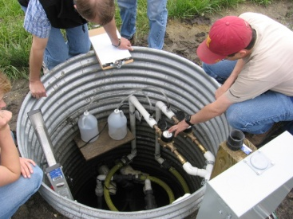
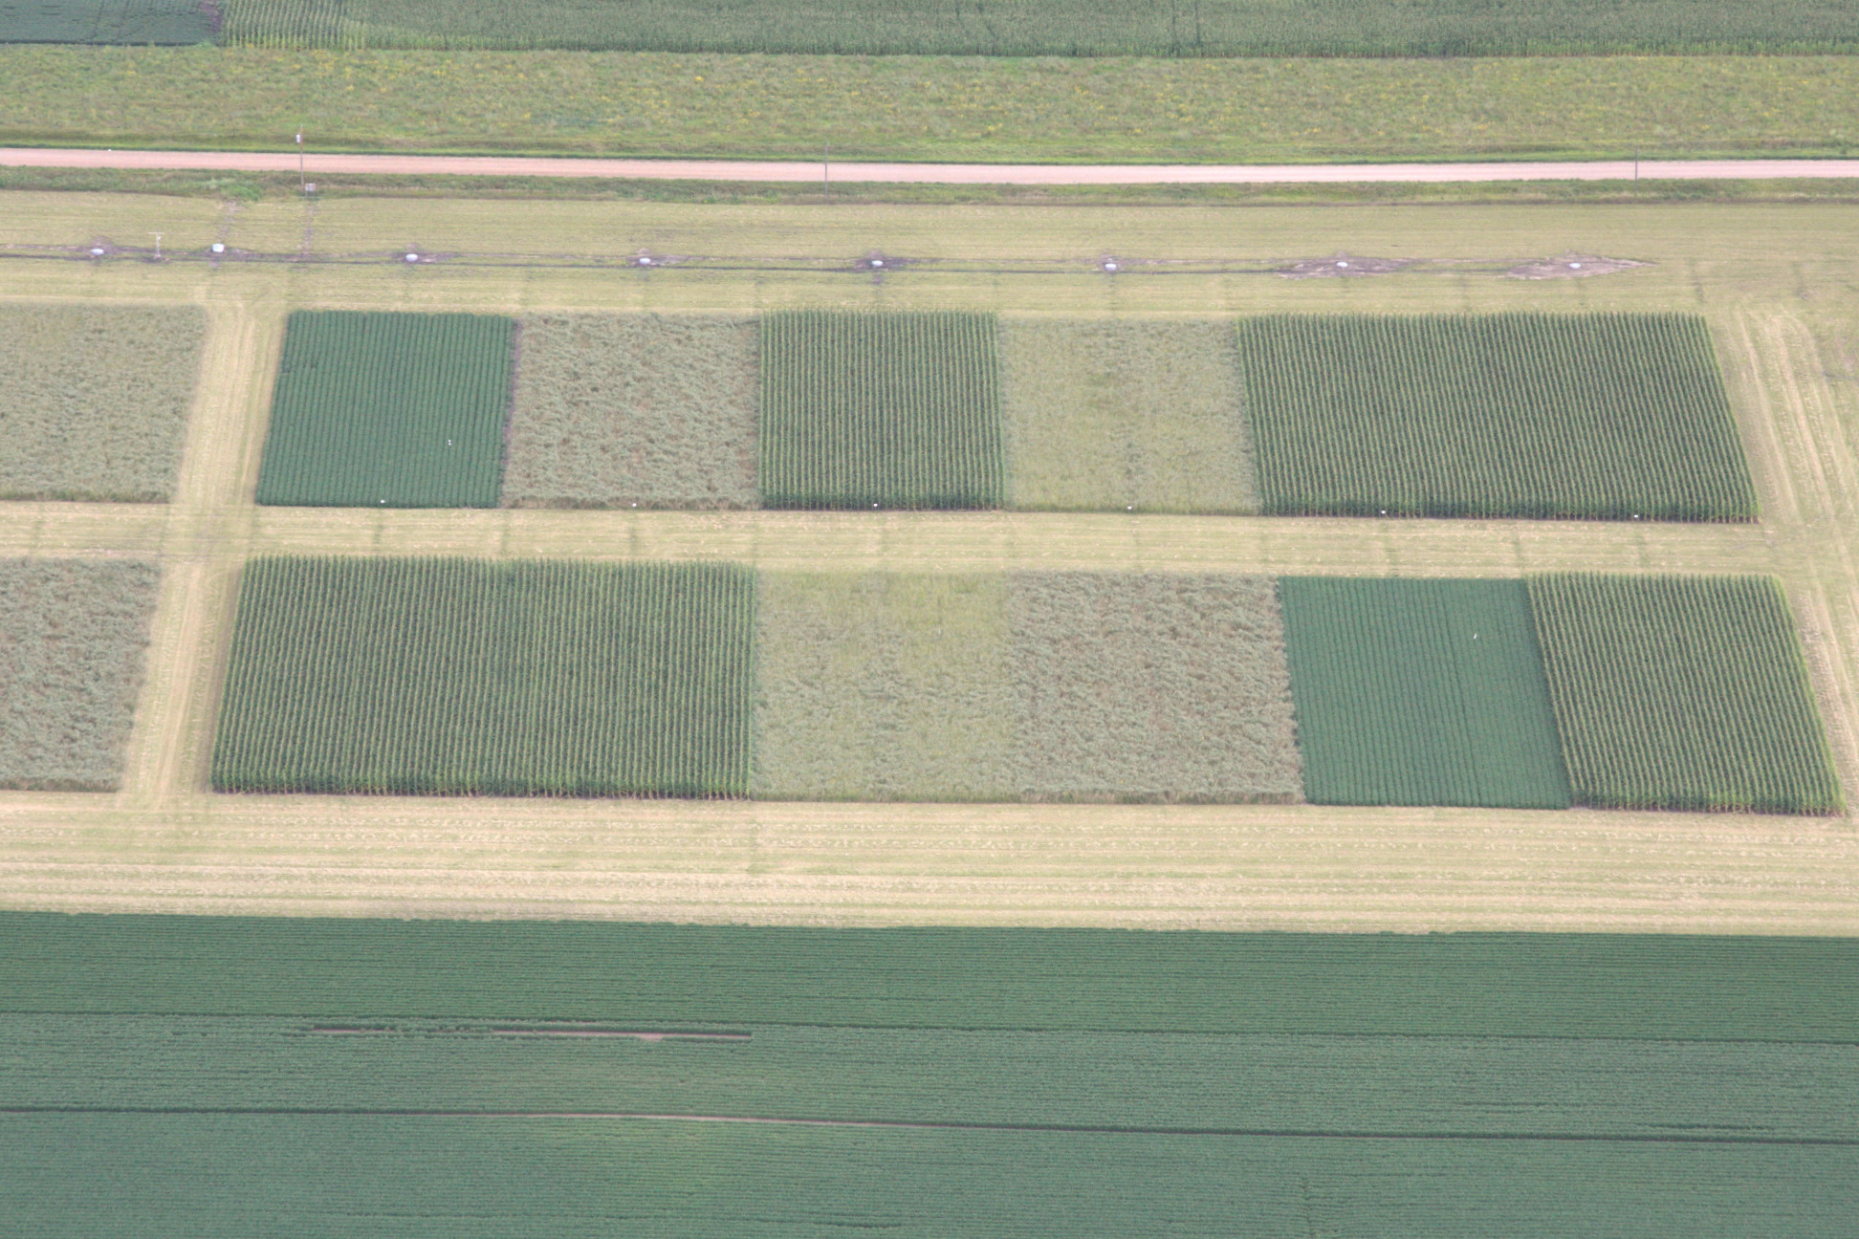


CCW
Continuous Corn +
Rye Cover Crop
C2
Corn-Soybean
S2
Soybean-corn
PF
Fertilized Prairie
P
Prairie
CC
Continuous Corn
Soil
Particle size analysis
Bulk density
Field capacity
Wilting point
pH
NO₃, NH₄
Soil C
Sensors
Soil moisture
Soil temp
Every 30 min
5 cm
10 cm
17.5 cm
30 cm
45 cm
Water
Each plot tiled
Flow monitored
every 5 minutes
Samples collected
for NO₃ and DOC
Plants
Aboveground biomass
bi-weekly
Belowground biomass
every eight weeks
Above/below N conc
Grain yields
Residue
Light interception
Prairie composition
GHG’s
CO₂
N₂O
CH₄
Met
Temp
Precip
Radn
Notes:
Let me show you the results relevant to sWUE.

Slide 8
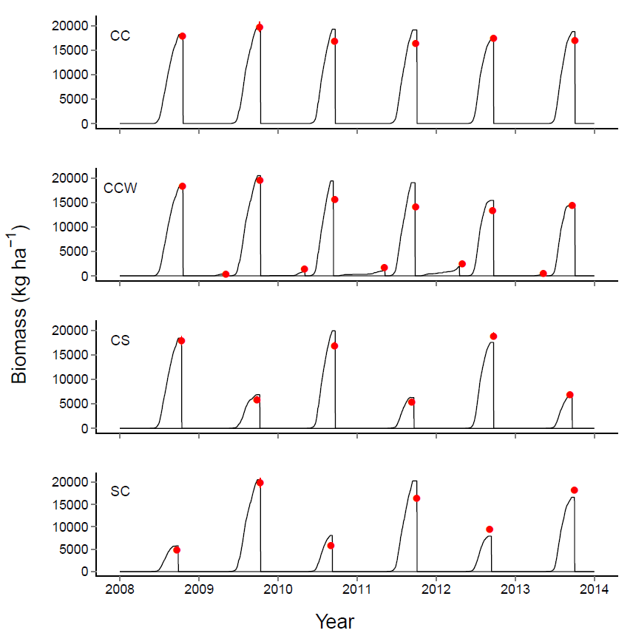
Simulated (lines) and observed (points) biomass at COBS over six years
RRMSE = 0.11 – 0.14
Notes:
This is important to getting the water budget right.

Slide 9
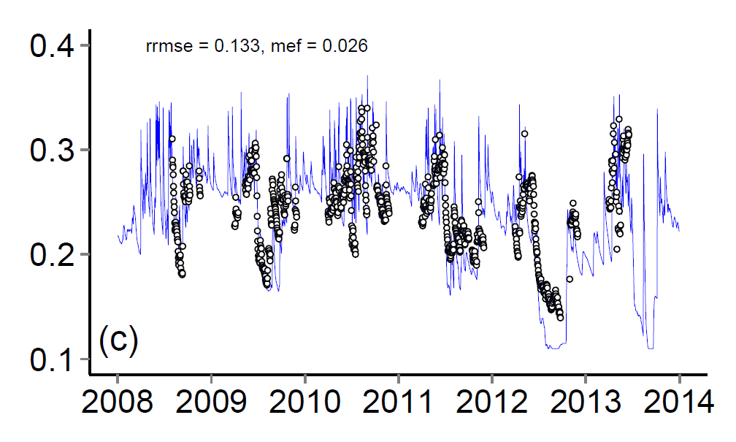
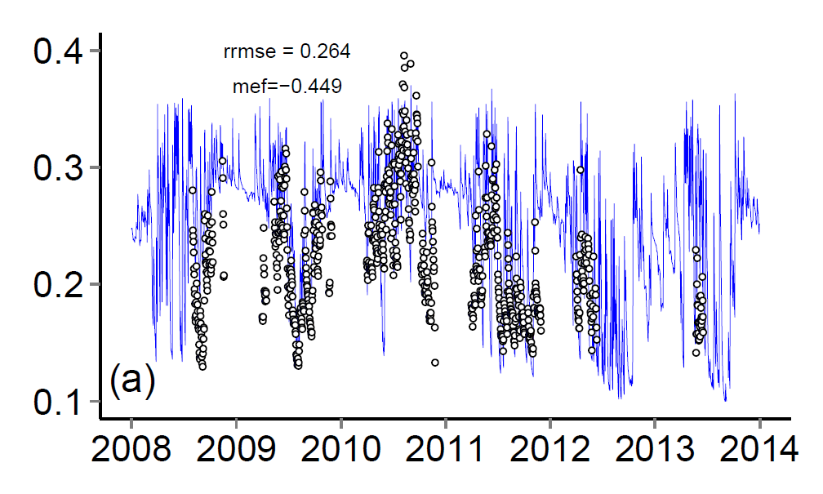
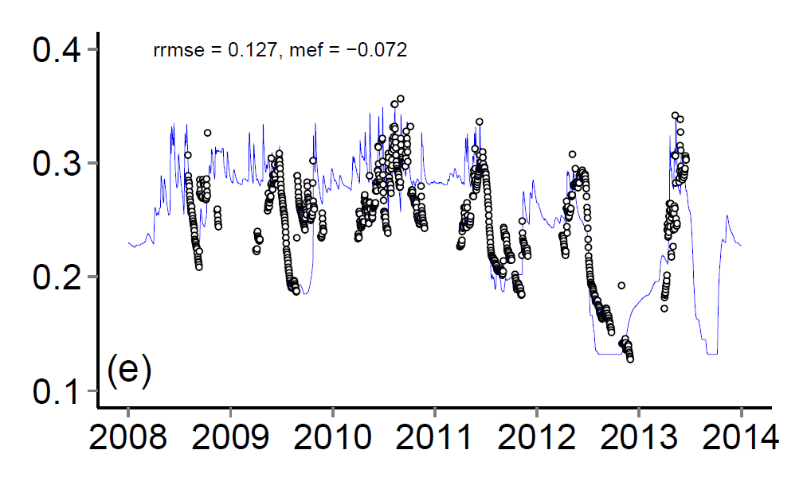
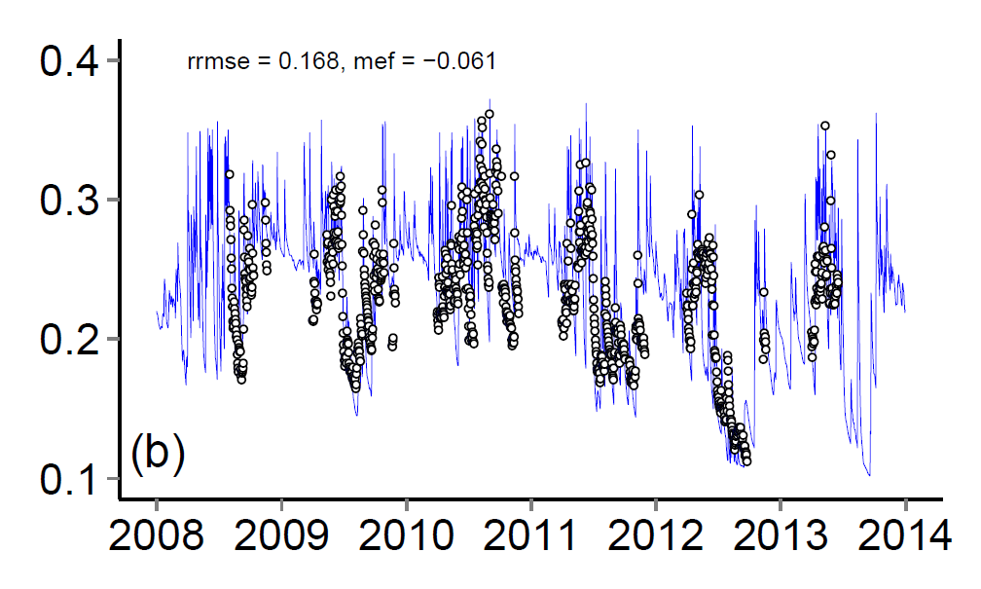
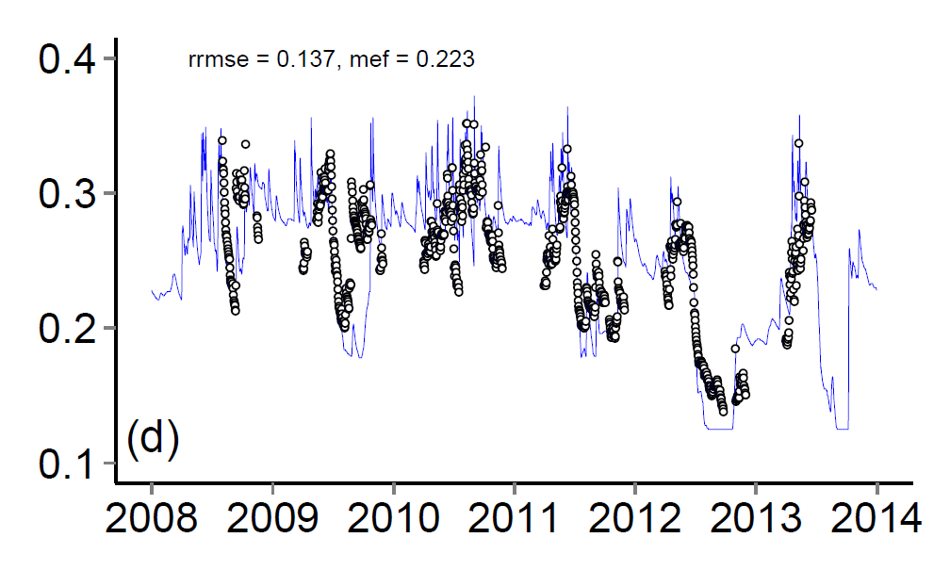
Simulated and observed daily soil moisture (mm/mm)
10 cm
Simulated and observed daily soil moisture (mm/mm)
15 cm
Simulated and observed daily soil moisture (mm/mm)
5 cm
Simulated and observed daily soil moisture (mm/mm)
50 cm
Simulated and observed daily soil moisture (mm/mm)
35 cm
Notes:
This gave us even more confidence that we were getting the water balance right.

Slide 10
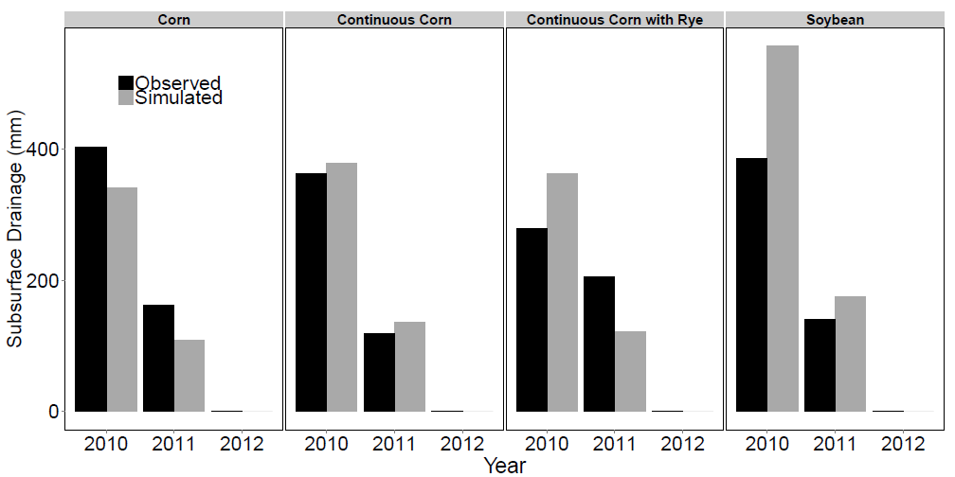
Tile Drainage
Notes:
And finally, as I mentioned, we had measurements for tile drainage. APSIM did really well except for 2010 in soybeans.

Slide 11
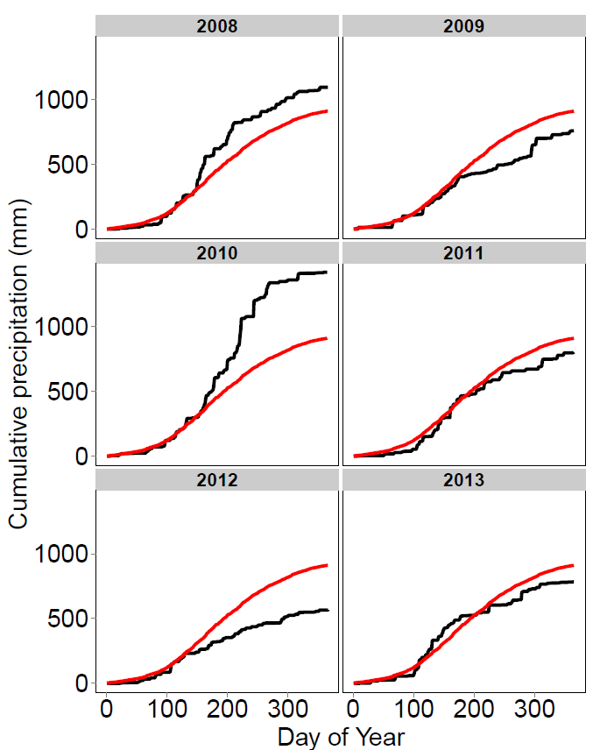
Climate
The study site experienced flood, drought, and historically average precipitation.

Slide 12
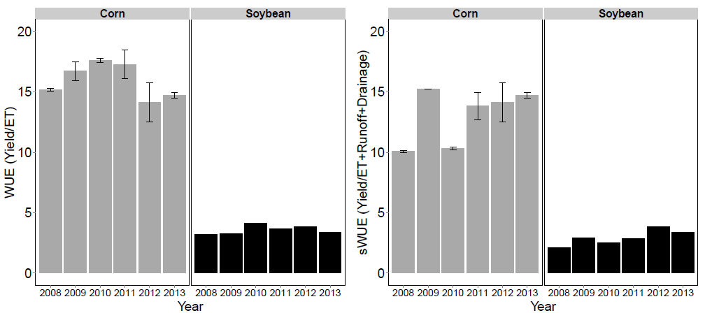
Efficiencies

Slide 13
The Midwestern United States is predicted to experience both more flooding and more drought.
When heavy rainfall does occur, events are predicted to be more intense relative to previous years.

Slide 14
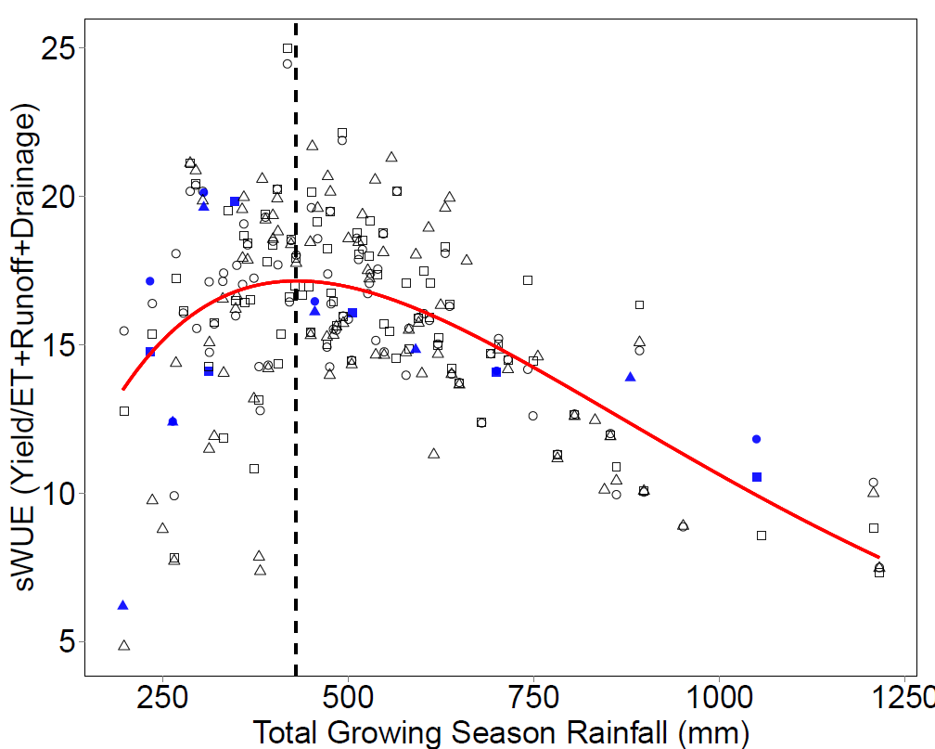
Systems water use efficiency in corn
During the years of study (blue)
For the past 30 years
For the past 30 years with +15% rain
For the past 30 years with -15% rain
Optimum growing season rainfall was 430 mm
or
17 inches.

Slide 15
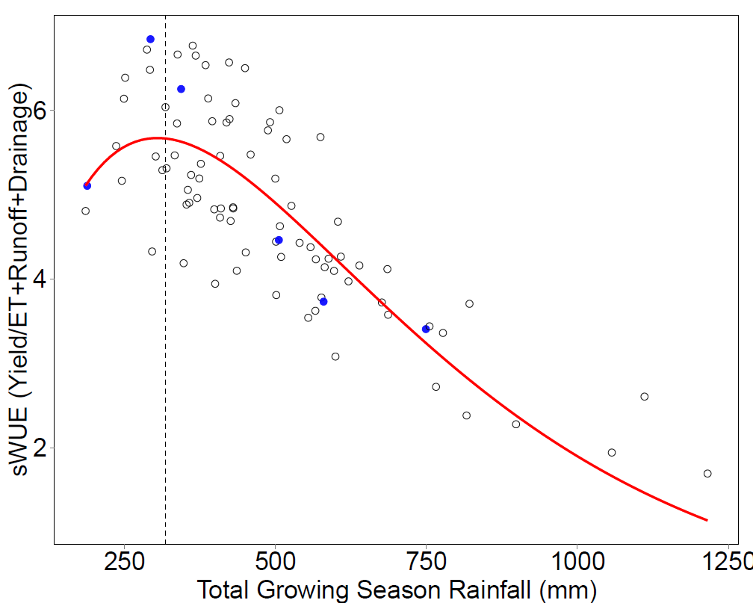
Systems water use efficiency in soybean
During the years of study (blue)
For the past 30 years
For the past 30 years with +15% rain
For the past 30 years with -15% rain
Optimum growing season rainfall was 317 mm
or
12 inches.

Slide 16
Higher frequency of both drought and flood is predicted for the Midwestern United States.
Our simulations, which reflect these changes, show we can expect more years with low sWUE.
Yields will be inhibited in dry years and water will pass through the system in wet years.

Slide 17
Field-scale cropping systems or whole farms should be modified to include both drought-tolerant and flood-tolerant plants.
This systems-level problem needs a systems-level solution.

Slide 18
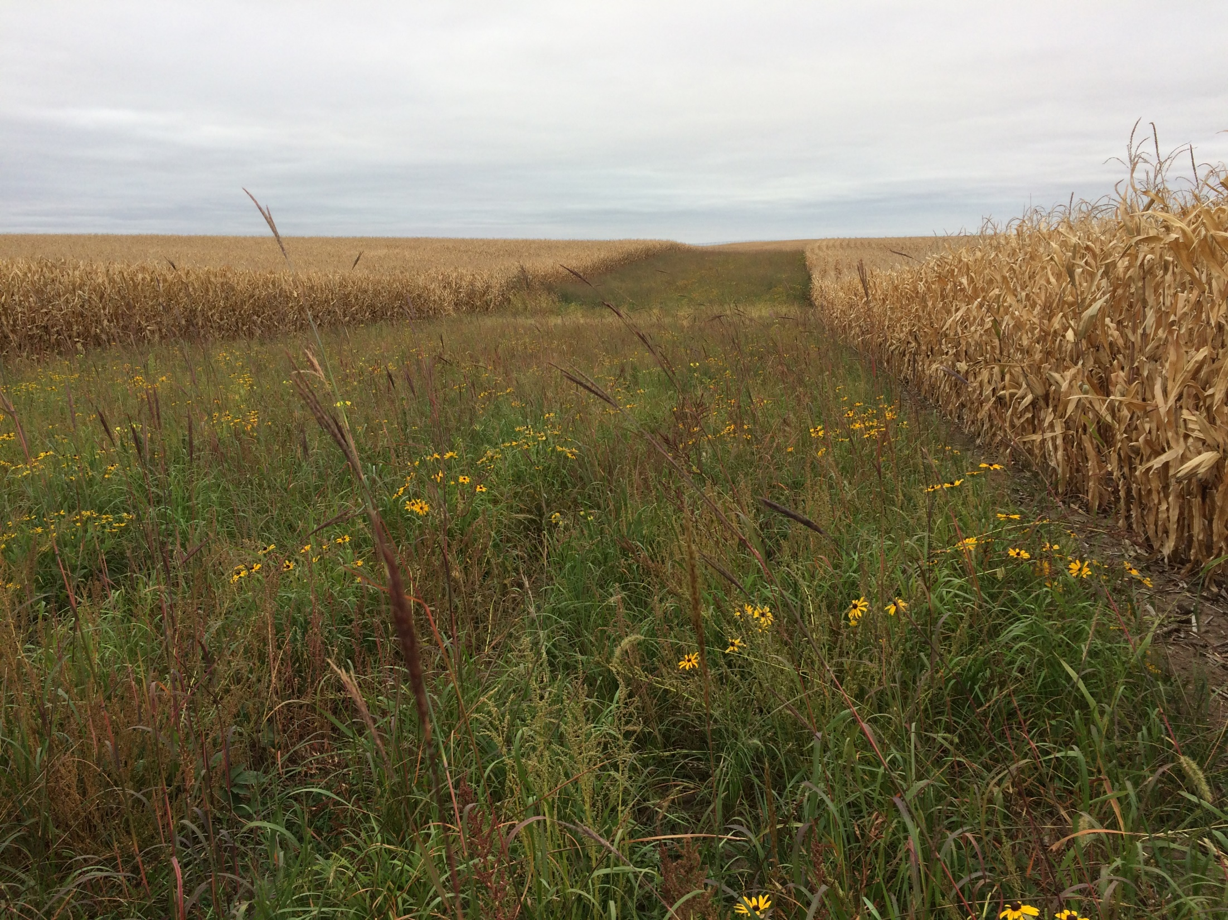
Incorporation of perennial prairie into row-cropped fields – STRIPS project.
https://www.nrem.iastate.edu/research/STRIPs/
Photo: Tim Youngquist

Slide 19
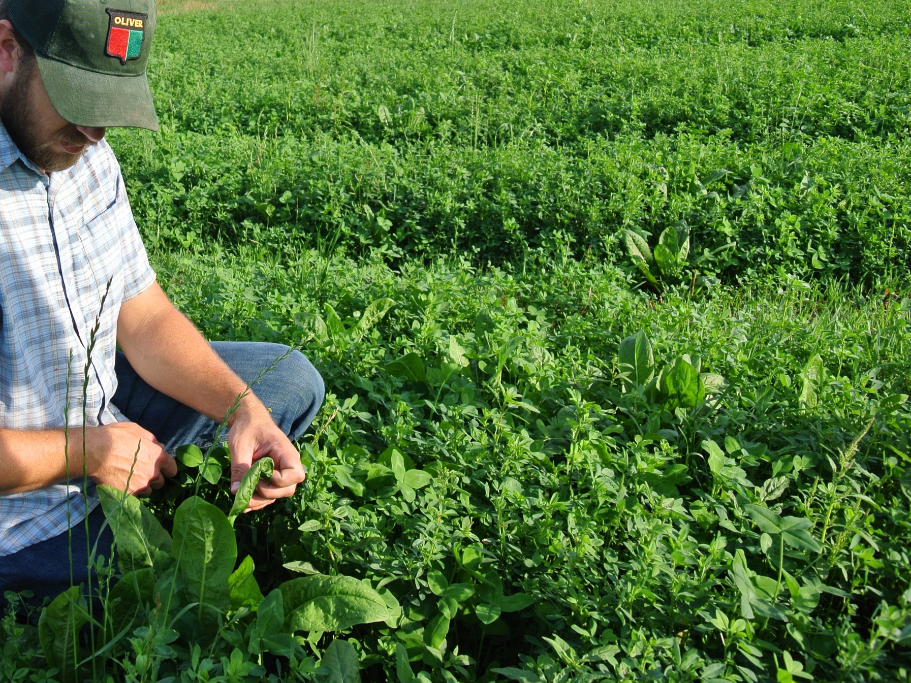
Increased acres of diverse hay and pasture.

Slide 20
Funding
Agriculture and Food Research Initiative Competitive Grant No. 2012-67011-1966
from the USDA National Institute of Food and Agriculture
ConocoPhillips Company
Iowa State University’s College of Agriculture and Life Sciences
Department of Agronomy
Graduate Program in Sustainable Agriculture
Wallace Chair for Sustainable Agriculture.
Thanks
Matt Liebman, Robert Ewing, Matt Helmers,
Robert Horton, Meghann Jarchow, and Sotirios Archontoulis
Isaiah Huber, Dave Sundberg, Carl Pedersen, and Aaron Daigh
Global Change Biology DOI: 10.1111/gcb.13101

Slide 21
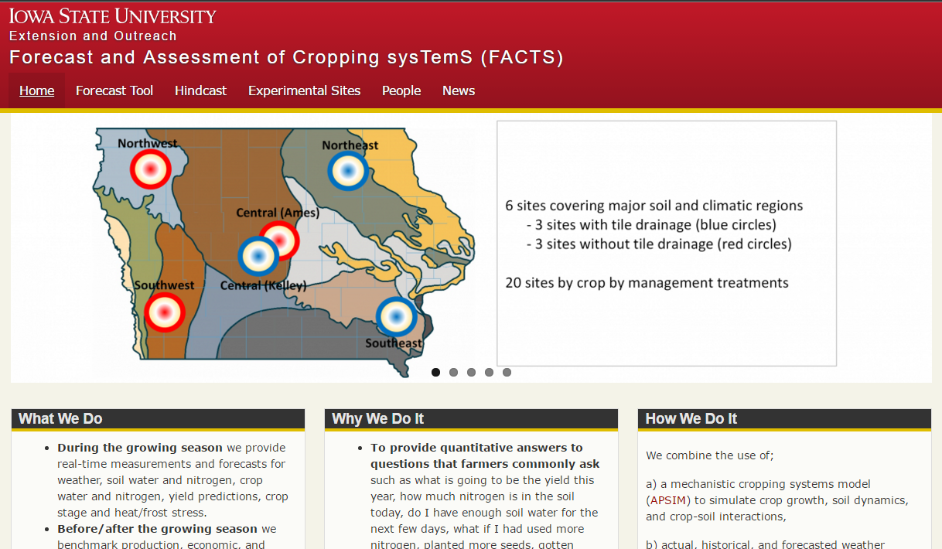
http://crops.extension.iastate.edu/facts/

Slide 22
